Slide 1

Entrepreneurial Intention Among Generation Z in Sri Lanka
Higher National Diploma in Software Engineering
(HDSE 23.1F)
Group 01
Notes:
To use this title animation slide with a new image simply 1) move the top semi-transparent shape to the side, 2) delete placeholder image, 3) click on the picture icon to add a new picture, 4) Move semi-transparent shape back to original position, 5) Update text on slide.

Slide 2
Group members
Dimuth Nilanjana HDSE231F-002
Hiru Amarajeewa HDSE231F-004
Dileesha Bandara HDSE231F-009
Thilina Shalom HDSE231F-013

Slide 3
Content
Introduction
Methodology
Data Analysis
Discussion
Question
Notes:
To use this title animation slide with a new image simply 1) move the top semi-transparent shape to the side, 2) delete placeholder image, 3) click on the picture icon to add a new picture, 4) Move semi-transparent shape back to original position, 5) Update text on slide.

Slide 4
01
Introduction
Explore factors influencing entrepreneurial aspirations of Sri Lanka's Generation Z.
Contribute to discussions on young entrepreneurship by studying opinions, tech interactions, and cultural influences.
Inform strategies and policies to nurture Generation Z's entrepreneurial spirit, benefiting both youth and the country's economy.

Slide 5
=>
Objectives
Explore Attitudes and Perceptions
Identify Influencing Factors
Assess Technological Adoption
Examine Cultural Impact
Provide Actionable Insights

Slide 6
=>
Independent Variables & Dependent Variable
what is the impact of personal attitudes on the entrepreneurial intention of generation z in Sri Lanka?
what is the impact of personality traits on the entrepreneurial intention of generation z in Sri Lanka?
what is the impact of subjective and social norms of different societies on the entrepreneurial intention of generation z in Sri Lanka?
what is the impact of entrepreneurial opportunities on the entrepreneurial intention of generation z in Sri Lanka?

Slide 7
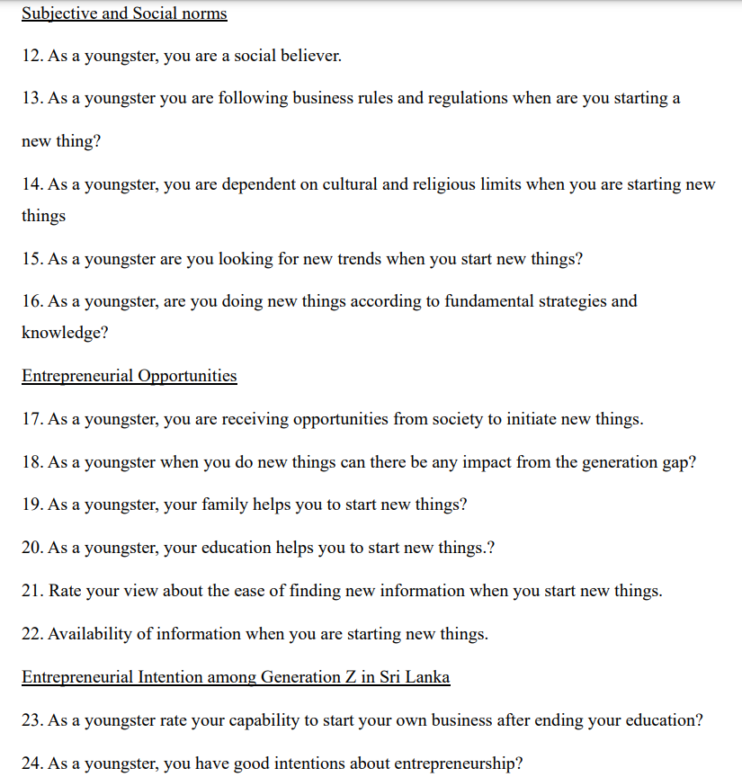
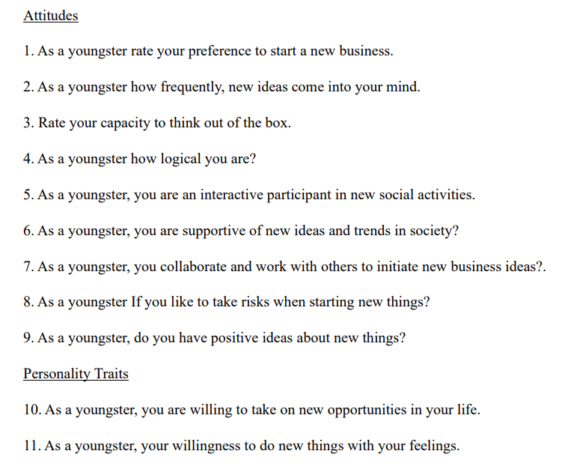
=>
Questions

Slide 8
This chapter begins with an explanation of the procedures used for data gathering, sampling, and analysis.
02 Methodology
Notes:
Tip:
When using complex image as full-bleed background add a transparency (70%-90%) fill layer to give contrast to text.

Slide 9
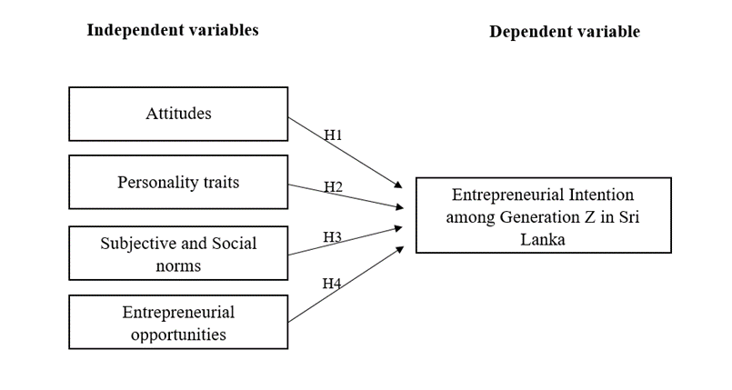
=>
Our Conceptual framework

Slide 10
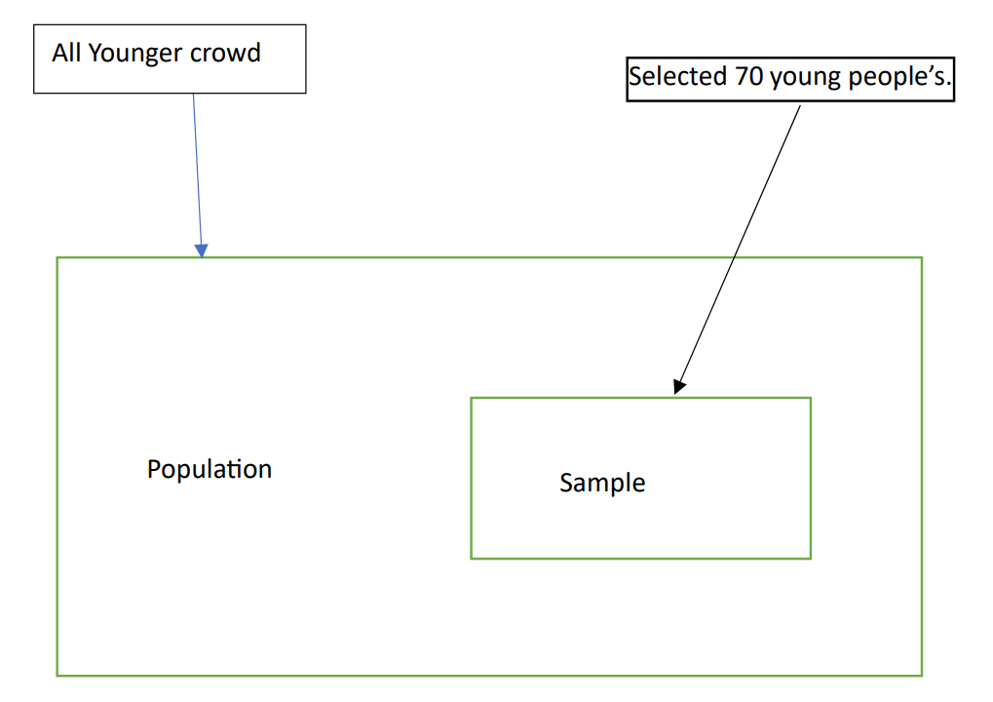
=>
Population & sample

Slide 11
=>
Methods of data Analysis
Descriptive statistics methods
Correlation Analysis
Regression Analysis
Graphical representations

Slide 12




03 Data Analysis
Normal Probability Plot
Correlation Test
Regression
ANOVA Table

Slide 13
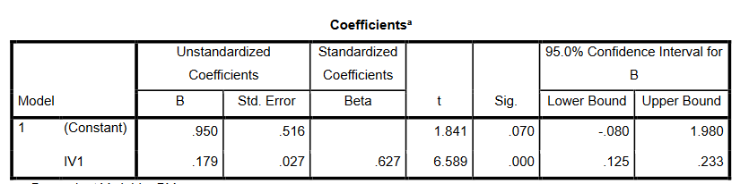
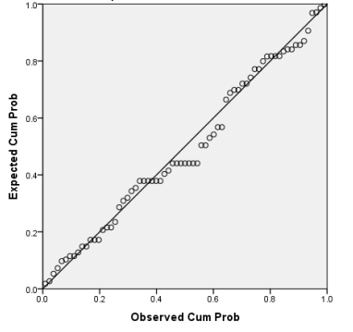
Relation between attitude and entrepreneurial intension
y=mx +c
m= 0.179
x = Attitudes
c= .950 y (Entrepreneurial Intention among Generation Z in Sri Lanka) = 0.179* (Attitudes) + .950

Slide 14
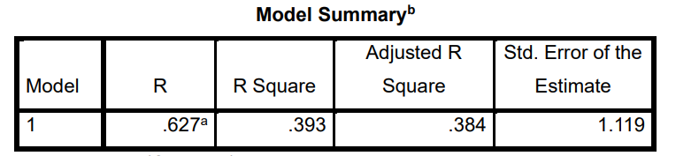
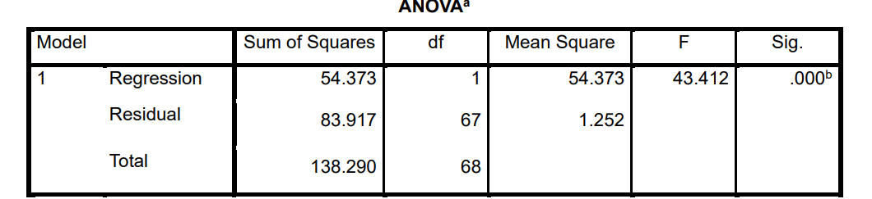
Model R: This is the correlation coefficient between the observed values of the dependent variable (DV) and the predicted values from the model. In this case, it is 0.627.
R Square: Also known as the coefficient of determination, R Square indicates the proportion of the variance in the dependent variable that is explained by the variance in the independent variable. In this model, approximately 39.3% (0.393) of the variability in the "Entrepreneurial Intention among Generation Z in Sri Lanka" can be attributed to variations in the "Attitudes" variable.
Adjusted R Square: This adjusts R Square for the number of predictors in the model, providing a more accurate measure of the model's explanatory power. Here, it's 0.384.
Std. Error of the Estimate: This is an estimate of the standard deviation of the residuals, which are the differences between the observed and predicted values. It gives an indication of how well the model's predictions match the actual data points. In this case, the standard error is 1.119.
A significant level (Sig) value of 0.000 is given in the ANOVA table.
Since the significance value is less than 0.05 (often denoted as α), which is a commonly used threshold for statistical significance, we follow the rule that if the Sig value is less than or equal to 0.05, we reject the null hypothesis (H0) and accept the alternative hypothesis (H1).
Therefore, in this case, because the Sig value is extremely low (0.000 < 0.05), we can conclude that there is indeed a significant relationship between attitudes and entrepreneurial intention among Generation Z in Sri Lanka.

Slide 15
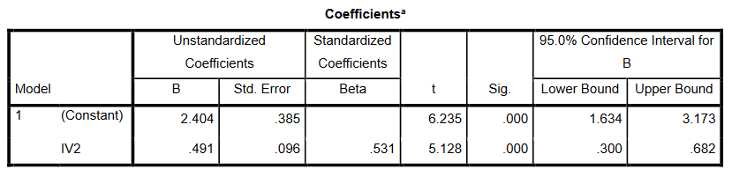
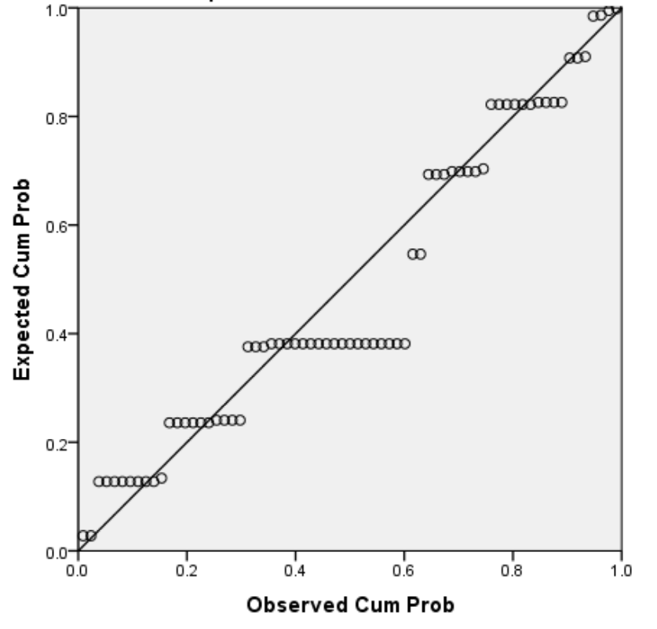
Relation between Personality traits and entrepreneurial intension
y=mx +c
m= 0. .491
x = Personality
c= 2.404 y (Entrepreneurial Intention among Generation Z in Sri Lanka) = 0. .491* (Personality) + 2.404

Slide 16
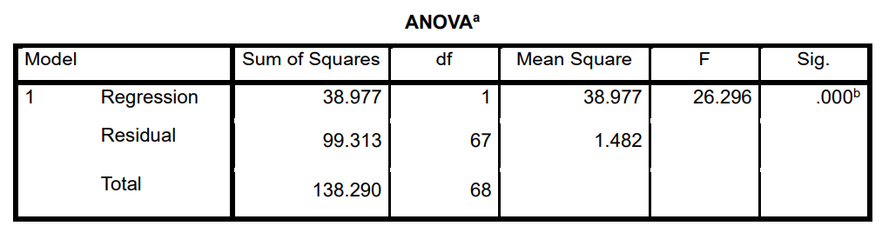
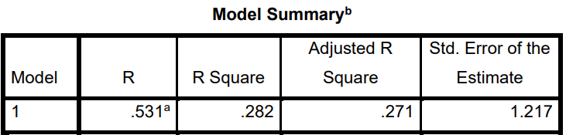
Model R: This is the correlation coefficient between the observed values of the dependent variable (DV) and the predicted values from the model. In this instance, it is 0.531.
R Square: Also known as the coefficient of determination, R Square quantifies the proportion of the variance in the dependent variable that can be attributed to the variance in the independent variable. In this model, around 28.2% (0.282) of the variability in "Entrepreneurial Intention among Generation Z in Sri Lanka" can be explained by variations in the "Personality" variable.
Adjusted R Square: This value adjusts R Square to account for the number of predictors in the model, providing a more accurate measure of the model's explanatory power. Here, it's 0.271.
Std.Error of the Estimate: This estimate provides information about how well the model's predictions align with the actual data points by indicating the standard deviation of the residuals, which are the differences between observed and predicted values. In this case, the standard error is 1.217.
A significance level (Sig) value of 0.000 is given in the ANOVA table.
Since the significance value is less than 0.05 (often denoted as α), which is a commonly used threshold for statistical significance, we apply the rule that if the Sig value is less than or equal to 0.05, we reject the null hypothesis (H0) and accept the alternative hypothesis (H1).
Therefore, in this case, because the Sig value is very low (0.000 < 0.05), we can conclude that there is indeed a significant relationship between personality traits and entrepreneurial intention among Generation Z in Sri Lanka.

Slide 17
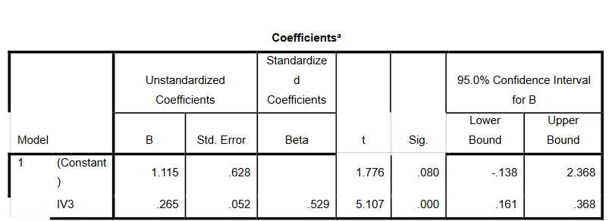
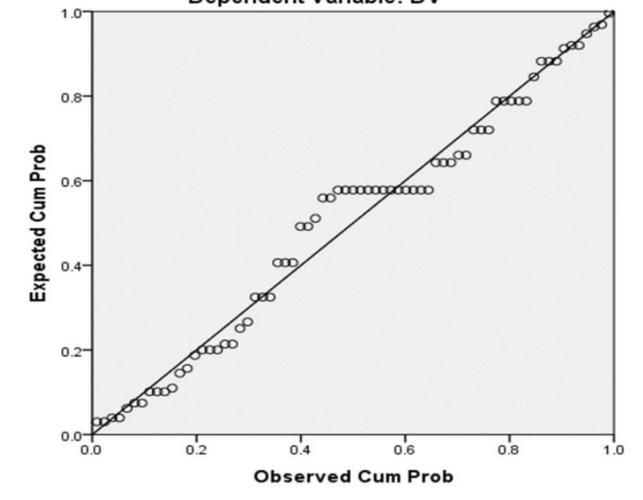
Relation between Subjective and Social norms and entrepreneurial intension
Anova
y=mx +c
m= 0.265
x = Subject and Social norms
c= 1.115 y (Entrepreneurial Intention among Generation Z in Sri Lanka) = 0.265* (Personality) + 1.115
Notes:
Combine an image and multiple key statements with a strong grid.

Slide 18
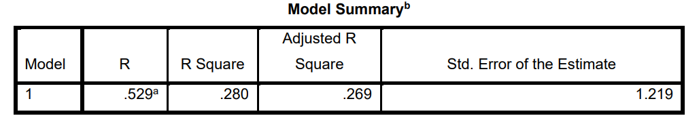
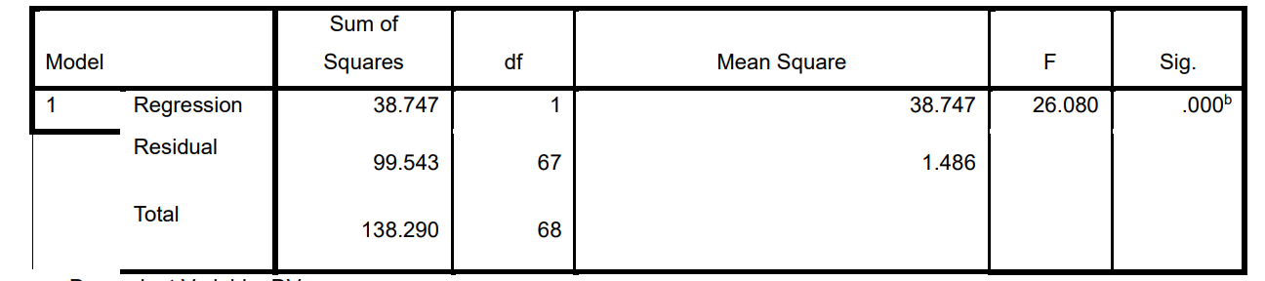
ANOVA
Model R: This value is the correlation coefficient between the observed values of the dependent variable (DV) and the predicted values from the model. In this specific case, the value is 0.529.
R Square: Also known as the coefficient of determination, R Square quantifies the proportion of the variance in the dependent variable that can be attributed to the variance in the independent variable. In this model, about 28.0% (0.280) of the variability in "Entrepreneurial Intention among Generation Z in Sri Lanka" can be explained by variations in the "Subjective and Social norms" variable.
Adjusted R Square: This value adjusts R Square to account for the number of predictors in the model, offering a more accurate measure of the model's explanatory power. In this case, it's 0.269.
Std. Error of the Estimate: This estimate provides information about how well the model's predictions align with the actual data points by indicating the standard deviation of the residuals, which are the differences between observed and predicted values. In this instance, the standard error is 1.219.
A significance level (Sig) value of 0.000 is provided in the ANOVA table.
Since the significance value is less than 0.05 (often denoted as α), which is a commonly used threshold for statistical significance, we follow the principle that if the Sig value is less than or equal to 0.05, we reject the null hypothesis (H0) and accept the alternative hypothesis (H1).
Therefore, in this case, because the Sig value is very low (0.000 < 0.05), we can conclude that there is indeed a significant relationship between subjective and social norms and entrepreneurial intention among Generation Z in Sri Lanka.

Slide 19
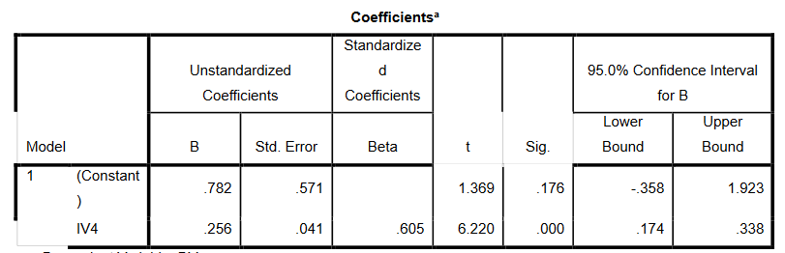
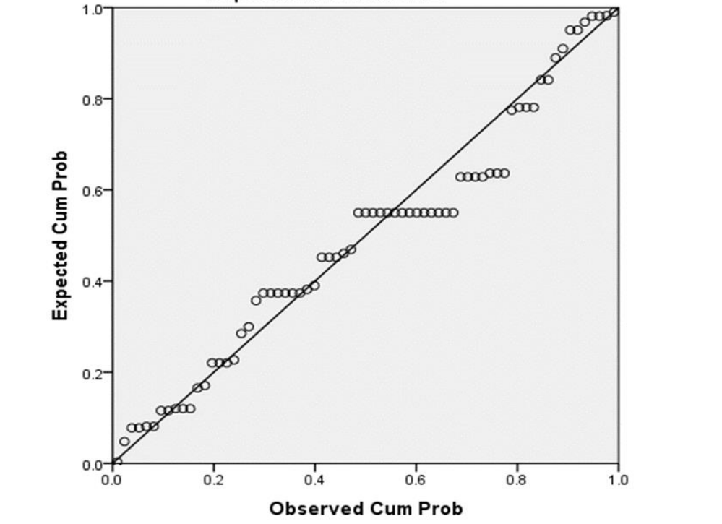
Relation between Entrepreneurial Opportunities and entrepreneurial intension
ANOVA
y=mx +c
m= 0.256
x = Entrepreneurial Opportunities
c= 0.782 y (Entrepreneurial Intention among Generation Z in Sri Lanka) = 0.265* (Entrepreneurial Opportunities) + 0.782

Slide 20
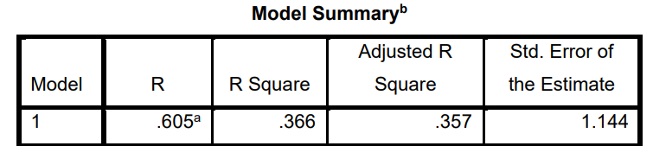
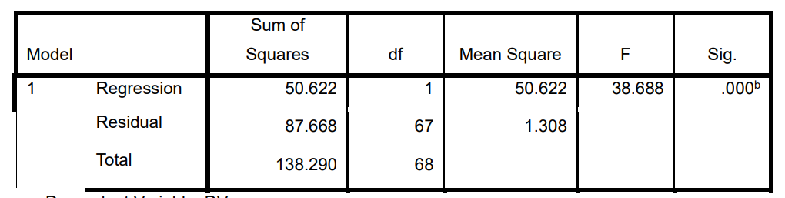
ANOVA
Model R: This value is the correlation coefficient between the observed values of the dependent variable (DV) and the predicted values from the model. In this specific case, the value is 0.605.
R Square: Also known as the coefficient of determination, R Square quantifies the proportion of the variance in the dependent variable that can be attributed to the variance in the independent variable. In this model, about 36.6% (0.366) of the variability in "Entrepreneurial Intention among Generation Z in Sri Lanka" can be explained by variations in the "Entrepreneurial Opportunities" variable.
Adjusted R Square: This value adjusts R Square to account for the number of predictors in the model, offering a more accurate measure of the model's explanatory power. In this case, it's 0.357.
Std. Error of the Estimate: This estimate provides information about how well the model's predictions align with the actual data points by indicating the standard deviation of the residuals, which are the differences between observed and predicted values. In this instance, the standard error is 1.144.
A significance level (Sig) value of 0.000 is given in the ANOVA table.
Since the significance value is less than 0.05 (often denoted as α), which is a commonly used threshold for statistical significance, we adhere to the guideline that if the Sig value is less than or equal to 0.05, we reject the null hypothesis (H0) and accept the alternative hypothesis (H1).
Therefore, in this case, since the Sig value is very low (0.000 < 0.05), we can conclude that there is indeed a significant relationship between entrepreneurial opportunities and entrepreneurial intention among Generation Z in Sri Lanka.

Slide 21
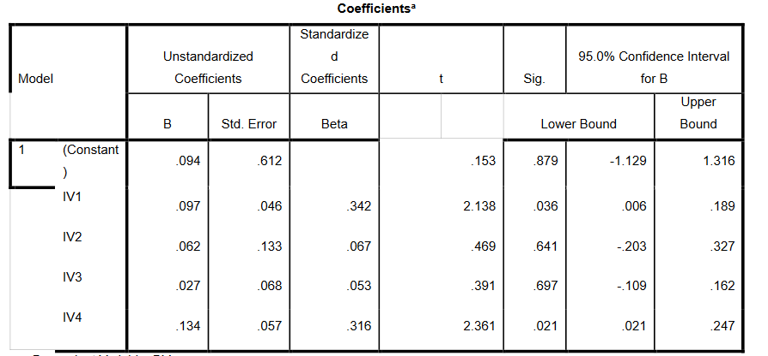
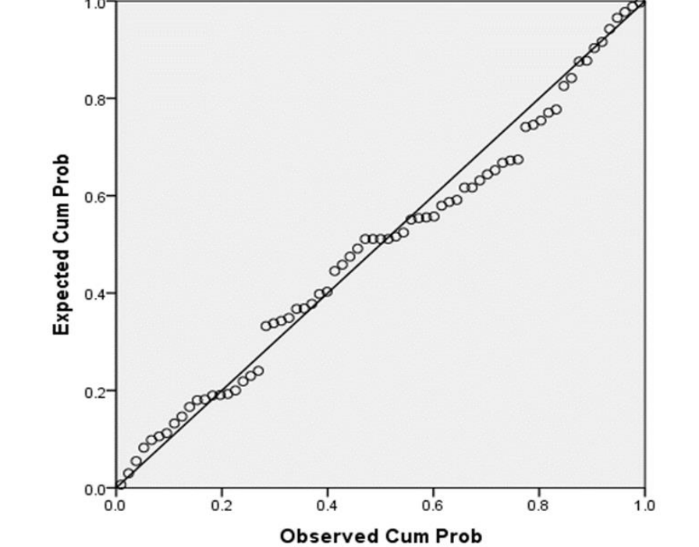
(Multiple Regression)
C = 0.094
IV1 = 0.097
IV2 = 0.062
IV3 = 0.027
IV4 = 0.134
Y = IV1 + IV2 + IV3 + IV4 + C Y (Entrepreneurial Intention among Generation Z in Sri Lanka) = 0.097 (Attitudes) + 0.062 (Personality Traits) + 0.027 (Subjective and Social norms) + 0.134 (Entrepreneurial Opportunities) + 0.094

Slide 22
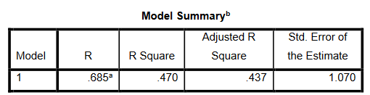
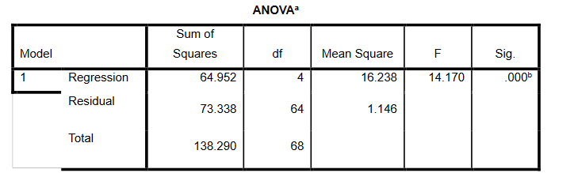
Model R: This value is the correlation coefficient between the observed values of the dependent variable (DV) and the predicted values from the model. In this specific case, the value is 0.685.
R Square: Also known as the coefficient of determination, R Square quantifies the proportion of the variance in the dependent variable that can be attributed to the variance in all the independent variables combined. In this model, approximately 47.0% (0.470) of the variability in "Entrepreneurial Intention among Generation Z in Sri Lanka" can be explained by variations in the set of independent variables (IV4, IV2, IV3, IV1).
Adjusted R Square: This value adjusts R Square to account for the number of predictors in the model, providing a more accurate measure of the model's explanatory power. In this case, it's 0.437.
Std. Error of the Estimate: This estimate provides information about how well the model's predictions align with the actual data points by indicating the standard deviation of the residuals, which are the differences between observed and predicted values. In this instance, the standard error is 1.070.

Slide 23
Discussion and Recommendations

Slide 24
Q & A
THANK YOU
Neal Creative | click & Learn more

